Slide 1
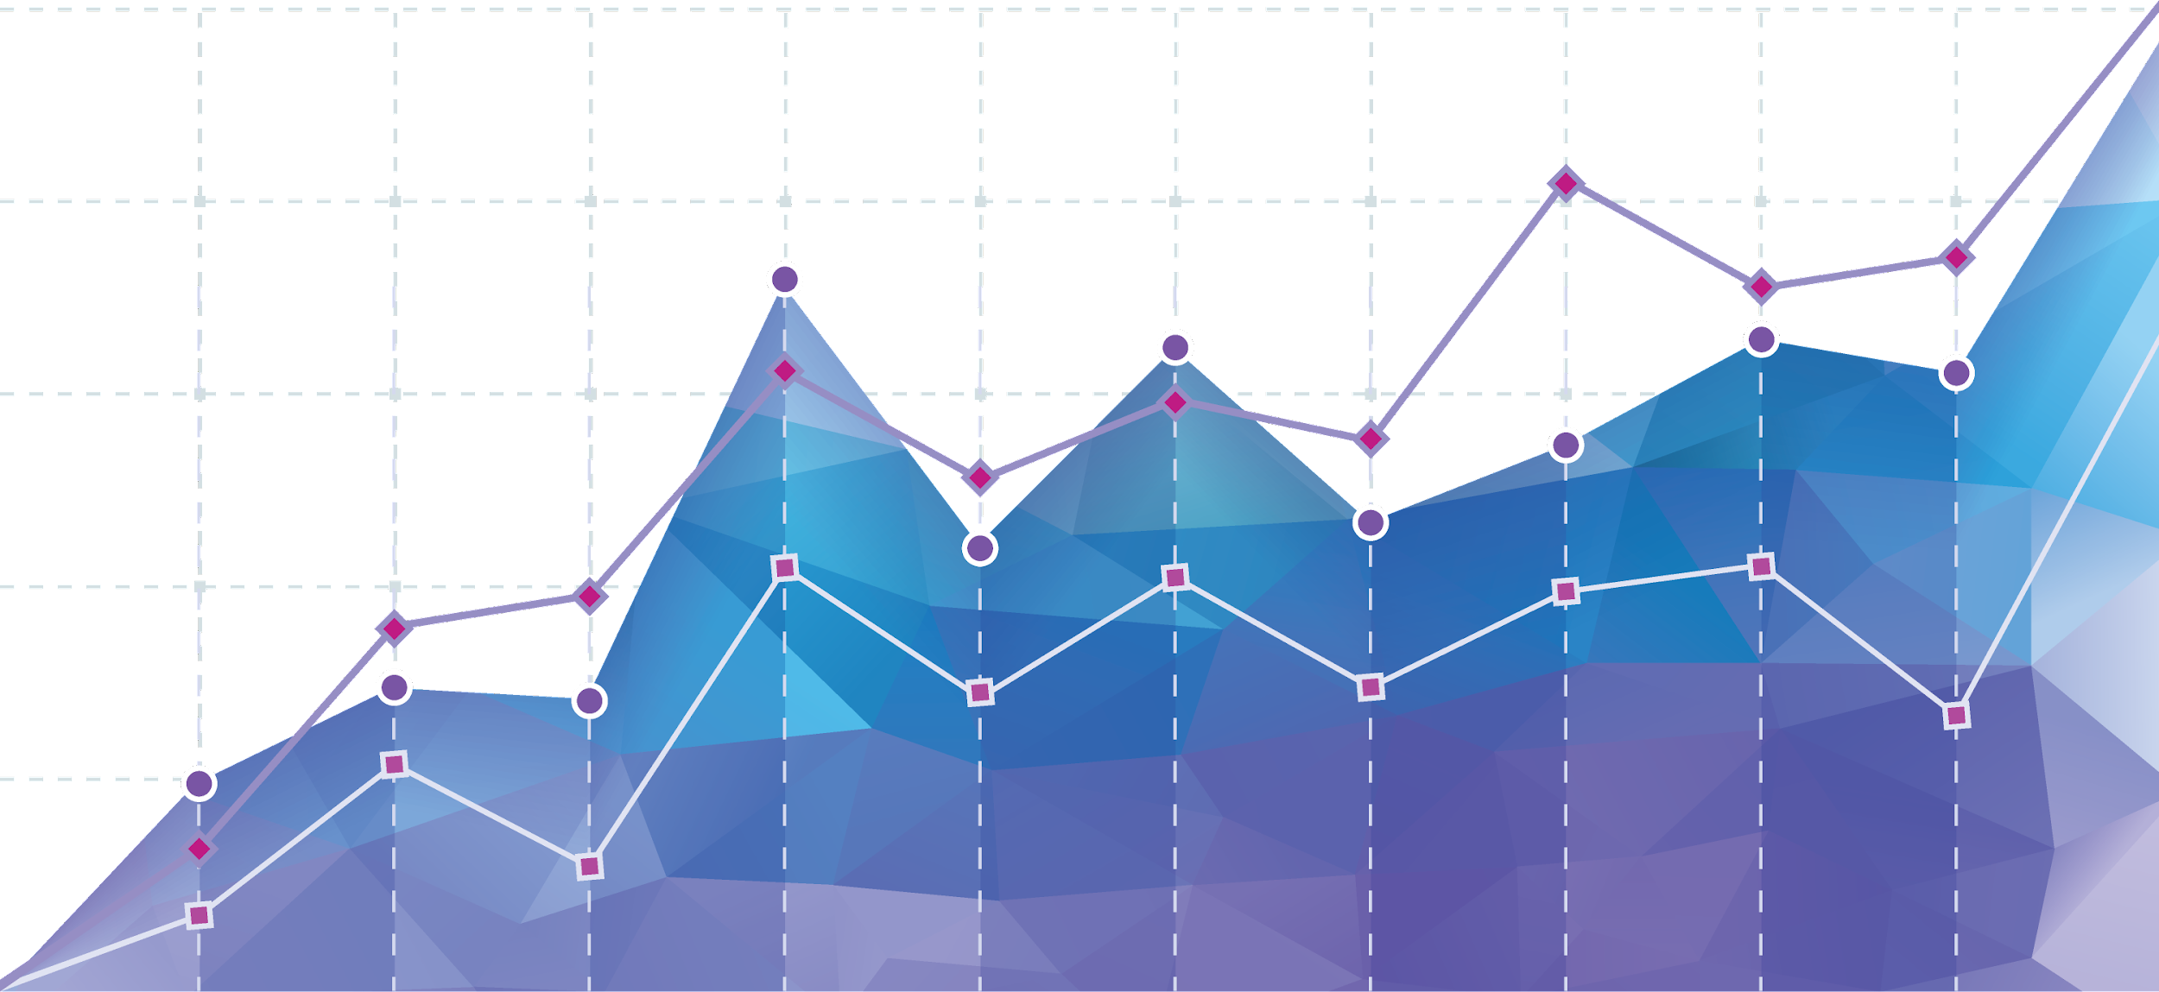
Data Visualization

Slide 2
Why do we visualize?

Slide 3
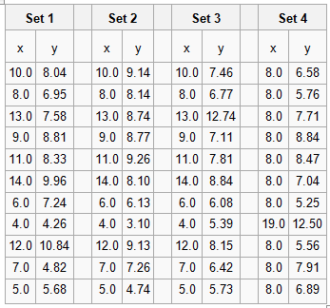
Why do we visualize?
...to see trends in the data
Example: Anscombe’s quartet
Nearly identical summary statistics:
Mean, variance, correlation, linear regression

Slide 4
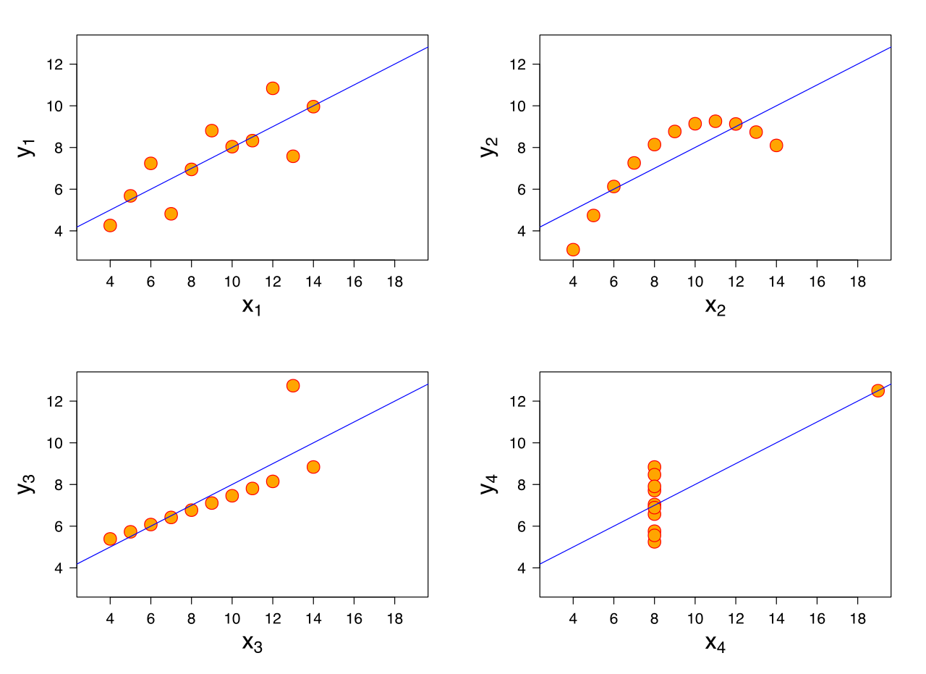
Why do we visualize?
...to see trends in the data
Example: Anscombe’s quartet
Nearly identical summary statistics:
Mean, variance, correlation, linear regression

Slide 5
Why do we visualize?
Tell yourself the story in the numbers
Identify patterns that look interesting
Use statistical tests to see if those patterns are significant
Tell others the story
Narrow down the figures to focus on the main takeaways
Annotate the figures with significant statistics

Slide 6
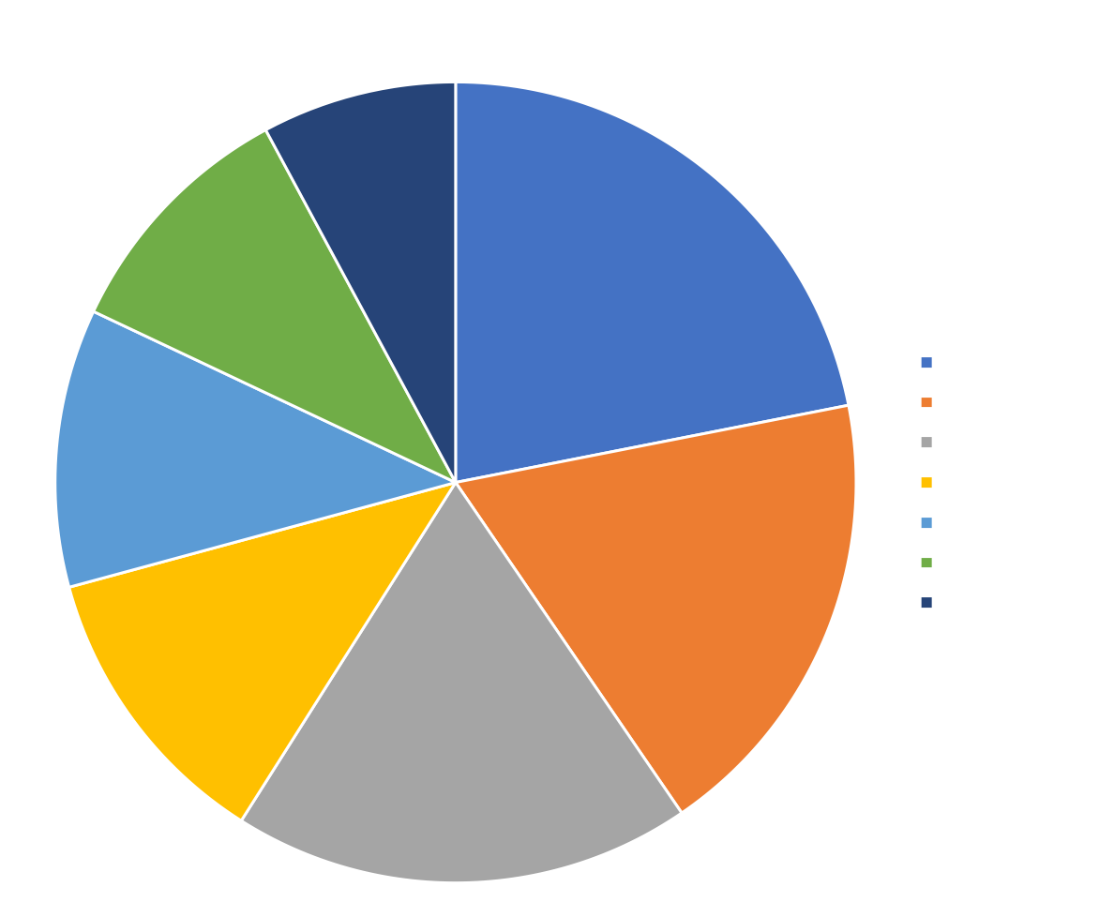
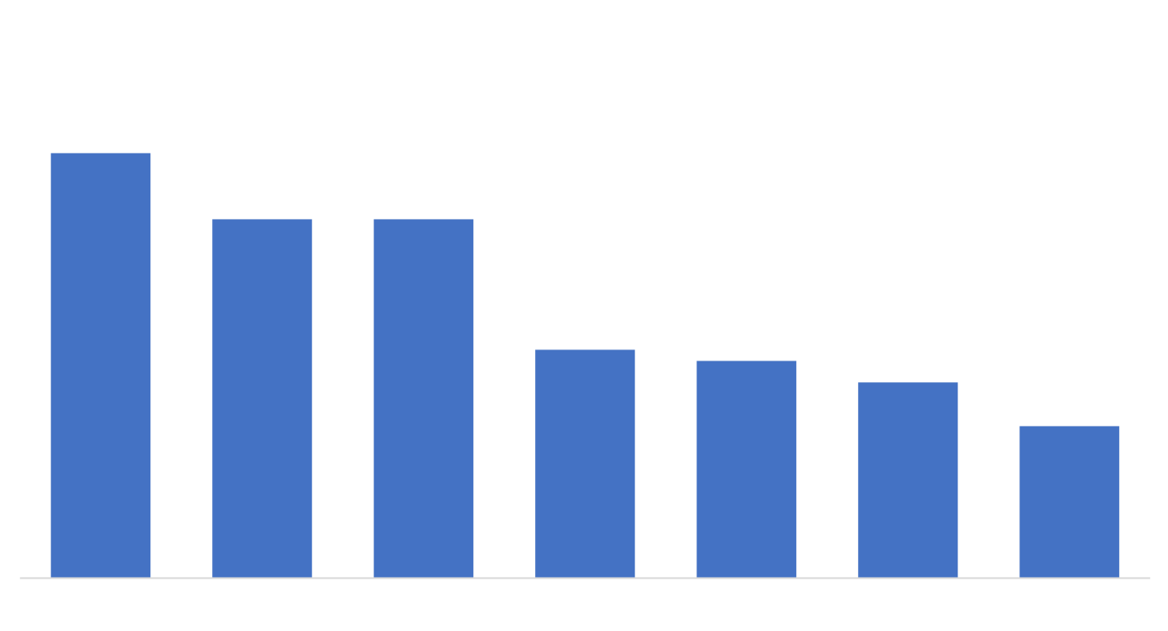
Which of these charts is more effective? Why?

Slide 7
Compare values across categories using a bar chart

Slide 8
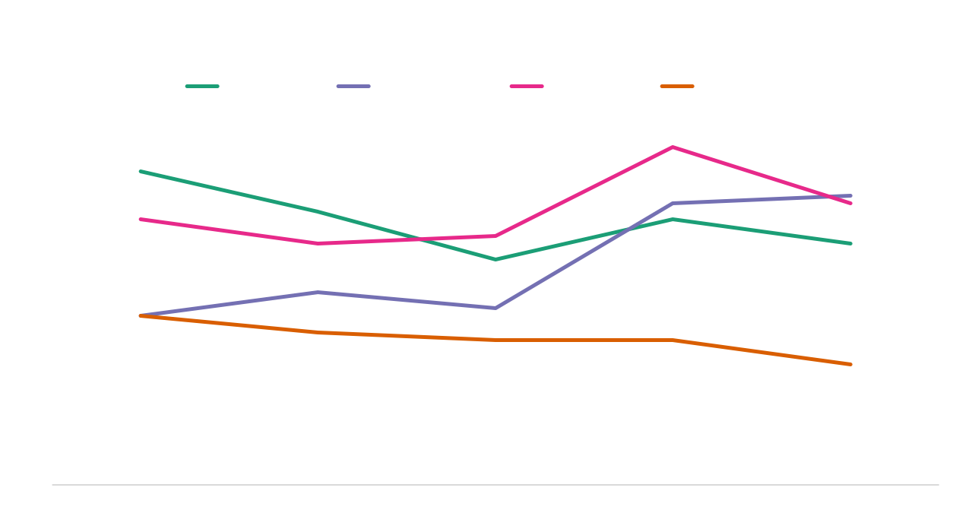
Show changes over time or space using a line graph

Slide 9
How do I visualize my data?

Slide 10
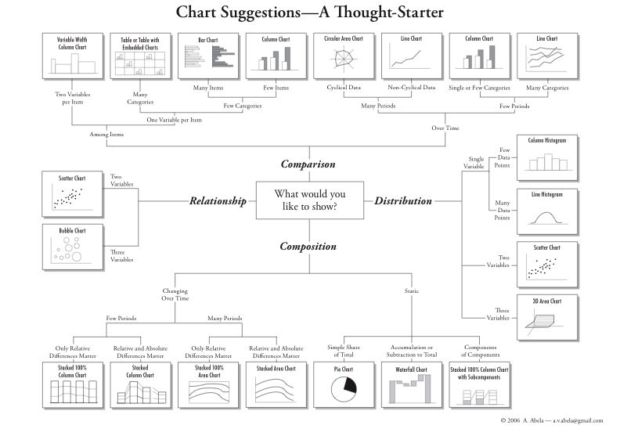

Slide 11
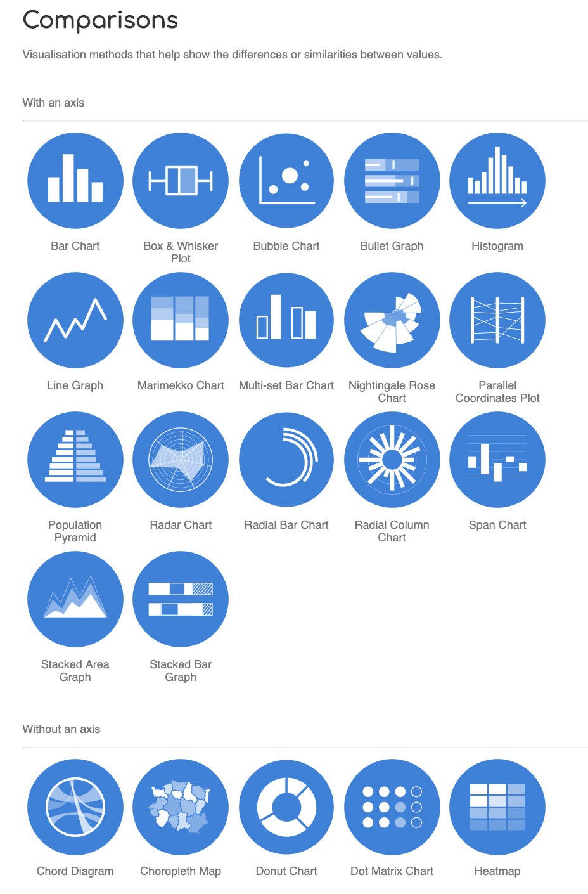
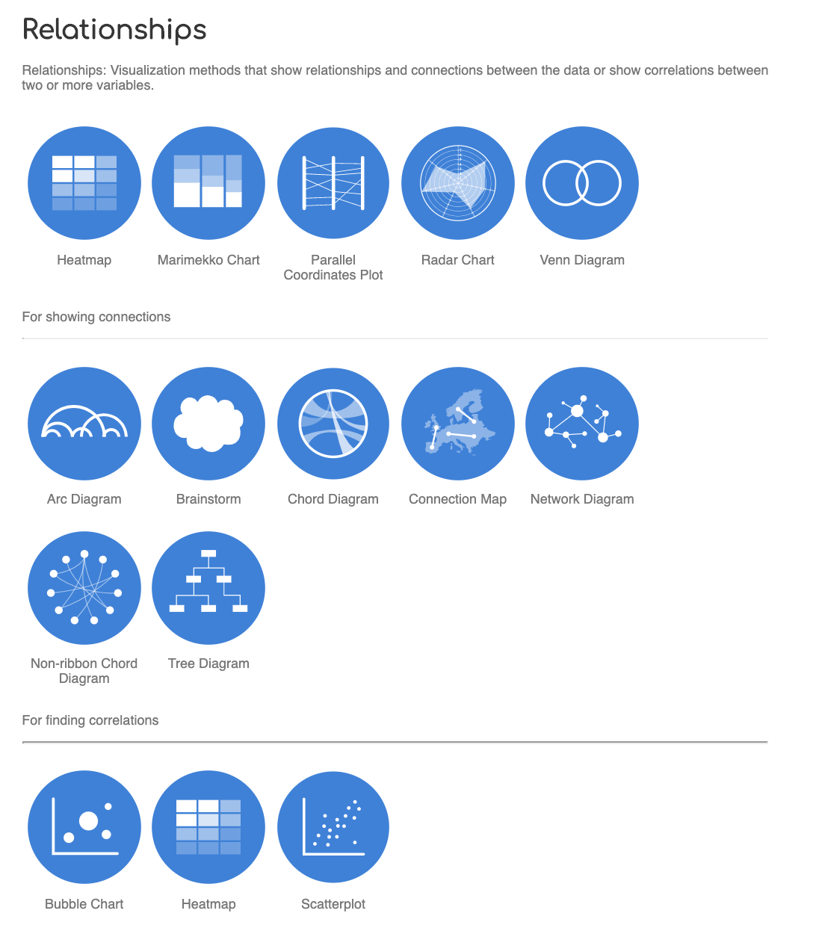
Selecting a chart
Select the appropriate chart type
datavizcatalogue.com

Slide 12
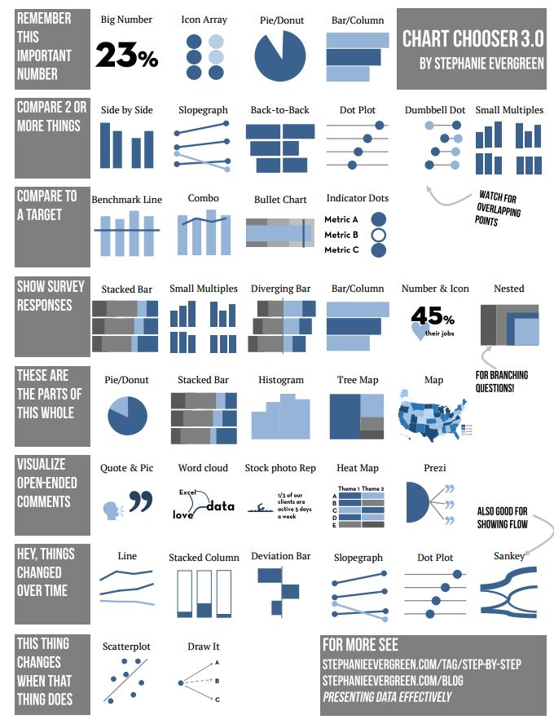
Notes:
There are many ways to visualize, and many visual encodings.

Slide 13
http://stephanieevergreen.com/category/blog/
Tutorials
Tips
Techniques

Slide 14
Formatting tips

Slide 15
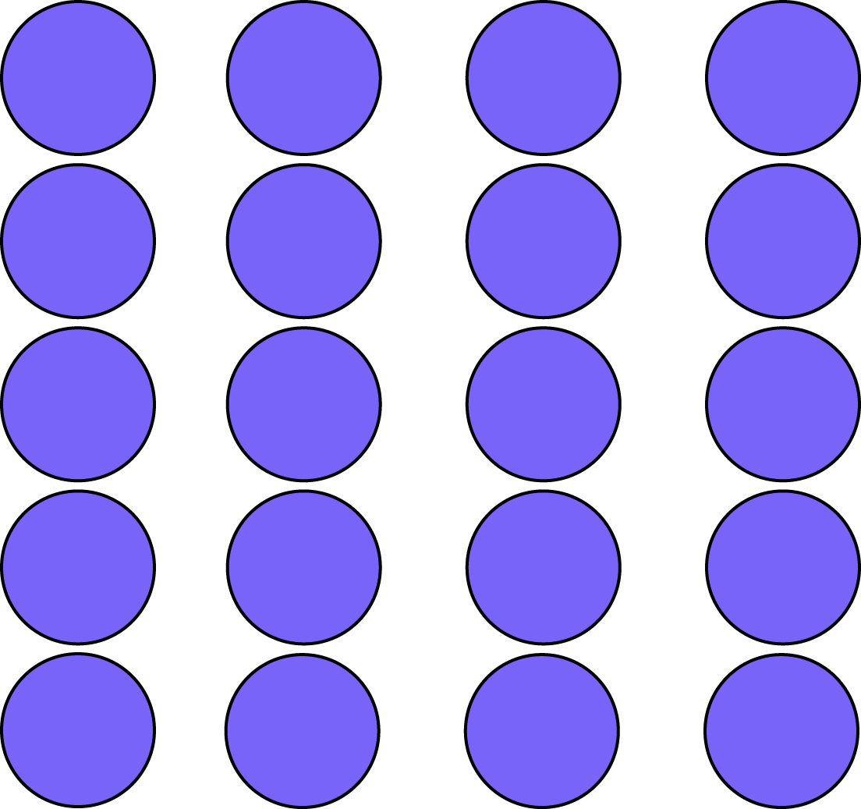
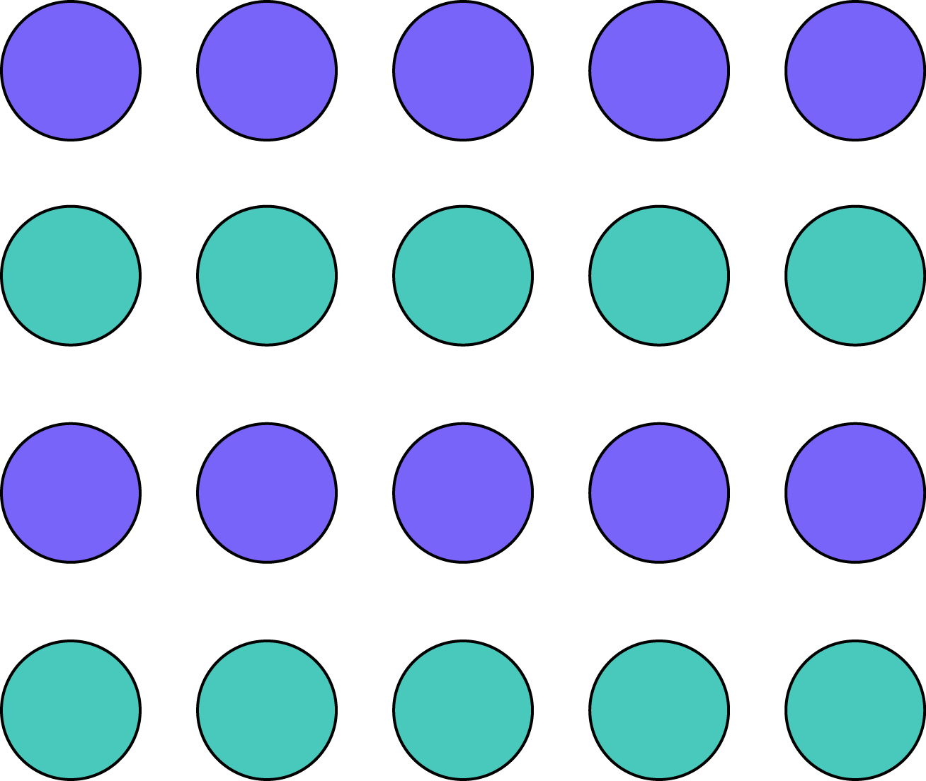
Organizing graphical elements
S P A C E
& GROUPING
Proximity
Similarity
Enclosure
Notes:
Another important element you can leverage is spacing. Our mind organizes individual visual elements into groups, to make sense of the entire visual. When designing a visualization, these principles can be used to highlight patterns that are important, reduce noise, and show relationships between elements more clearly. Spacing is extremely important because these interpretations happen automatically.
Proximity: We see three rows of dots instead of twelve dots because they are closer horizontally than vertically.
Similarity: We see similar looking objects as part of the same group.
Enclosure: We group the first four and and last four dots as two rows instead of eight dots.
Symmetry: We see three pairs of symmetrical brackets rather than six individual brackets.
Closure: We automatically close the square and circle instead of seeing three disconnected paths.
Continuity: We see one continuous path instead of three arbitrary ones.
Connection: We group the connected dots as belonging to the same group.
Figure & ground: We either notice the two faces, or the vase. Whichever we notice becomes the figure, and the other the ground.
Source: http://www.fusioncharts.com/blog/2014/03/how-to-use-the-gestalt-principles-for-visual-storytelling-podv/

Slide 16
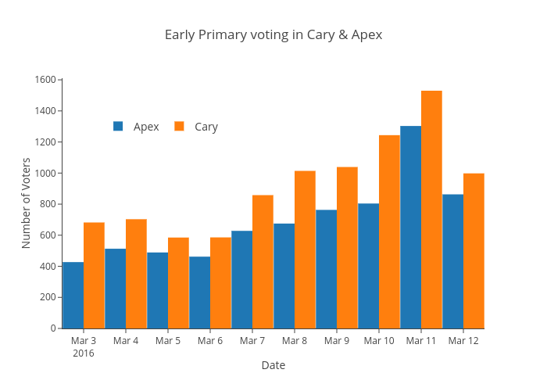
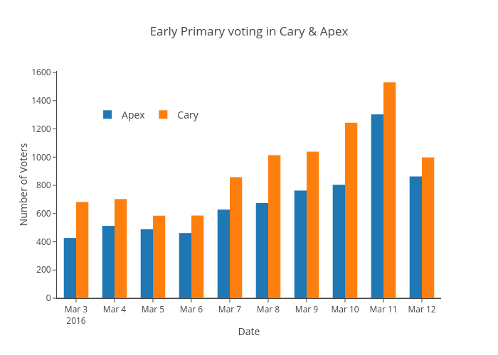
Proximity
S P A C E
& GROUPING

Slide 17
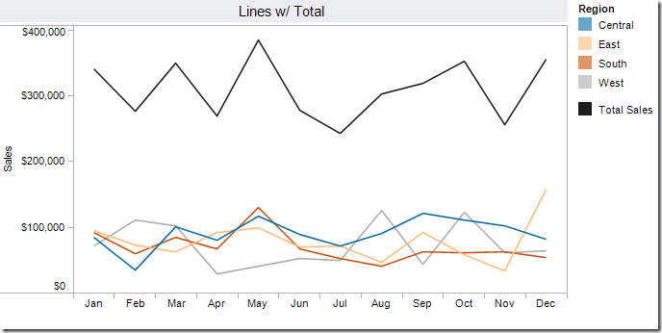
Make it easy to do comparisons.

Slide 18
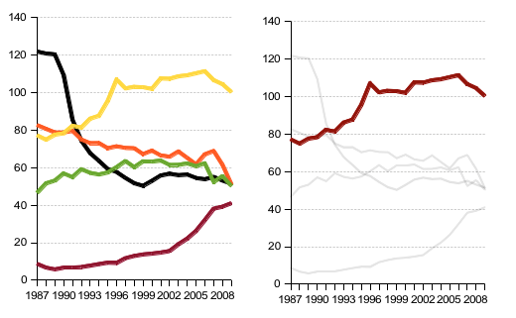
Color is helpful. Use contrast for salience!

Slide 19
Color is helpful. Use contrast for salience!

Slide 20
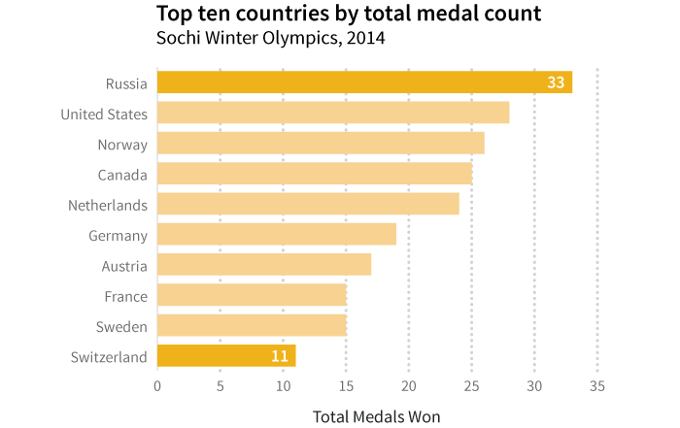
Type/text
Type Systems in Visualizations
1
Use different weights and sizes in data visualizations too.
2
4
5
5
3
Notes:
This graph has 5 different levels of type. You can use bold and small changes in type size (+ or - 2 pts) to differentiate different types of information.

Slide 21
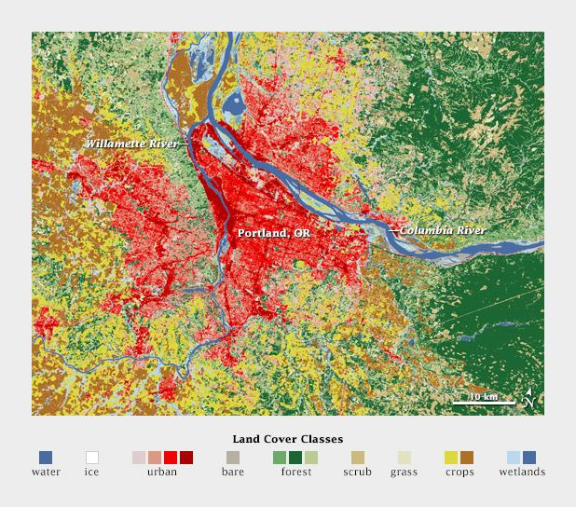
Color
Choose different hues for categorical data
Source: https://visual.ly/blog/subtleties-of-color-different-types-of-data-require-different-color-schemes/
Notes:
Here’s a categorical map showing different types of land cover in Portland, Oregon. Note that they have more than 12 different categories, but similar classes are grouped together in order to make the visualization intelligible. Four urban densities are shown in shades of red, three forest types in shades of green, and different types of cropland in yellow and brown.
Color has cultural and physical associations.
Source: https://visual.ly/blog/subtleties-of-color-different-types-of-data-require-different-color-schemes/

Slide 22
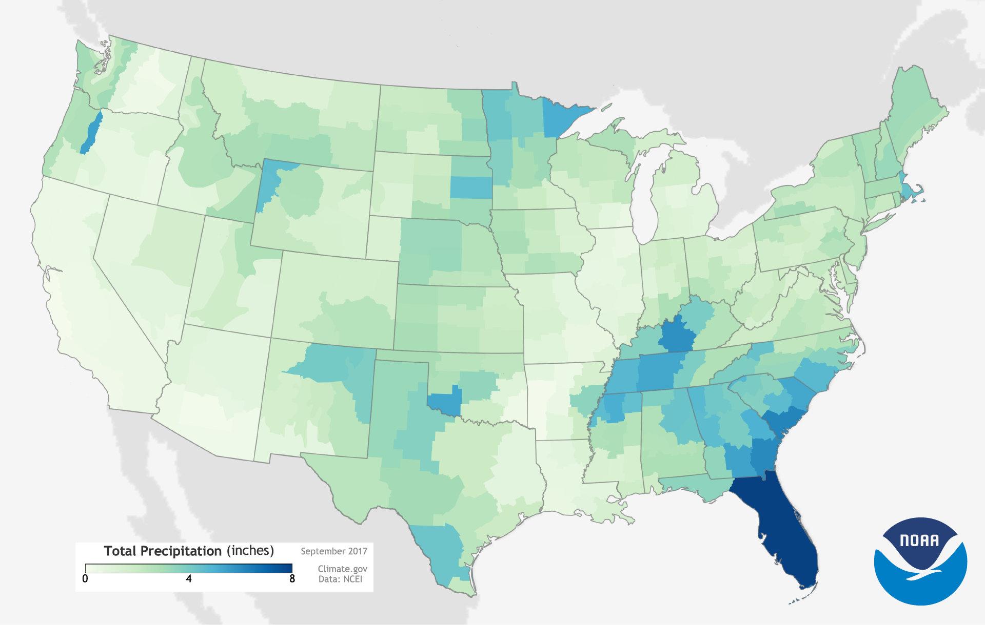
Color
Use an ordered palette for ordered data
Greys
Blues
YlGnBu
YlOrRd
Source: https://www.climate.gov/maps-data
Notes:
When visualizing quantitative data, use an ordered palette. An ordered palette can be a brightness ramp (e.g., light to dark shades of grey, blue, or red) or a hue ramp (e.g., cycling from light yellow to dark blue). In general, people interpret darker colours as representing “more.”
Source: https://betterfigures.org/2015/06/23/picking-a-colour-scale-for-scientific-graphics/

Slide 23
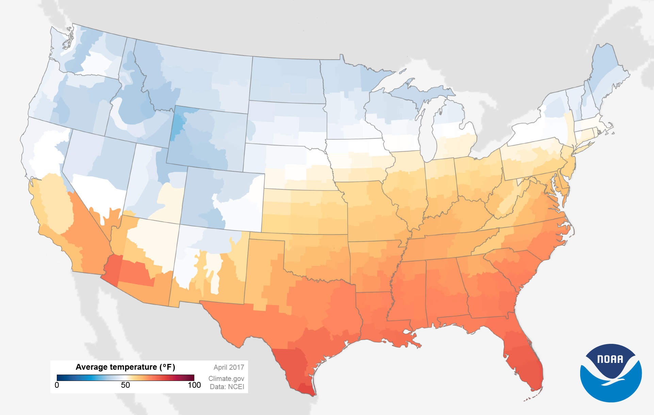
Color
Use a diverging palette for diverging data
RdBu
RdYlBu
PuOr
Notes:
If the data are diverging (i.e., the data straddle zero, or show a departure from a reference value) then use two contrasting hue or brightness ramps stuck together. These often have the darker colours at each end, representing “more negative” and “more positive.”
Source: https://betterfigures.org/2015/06/23/picking-a-colour-scale-for-scientific-graphics/

Slide 24
What colors could you use to visualize
cut vs uncut data?

Slide 25
What colors could you use to visualize
cut vs uncut data?
cut
uncut

Slide 26
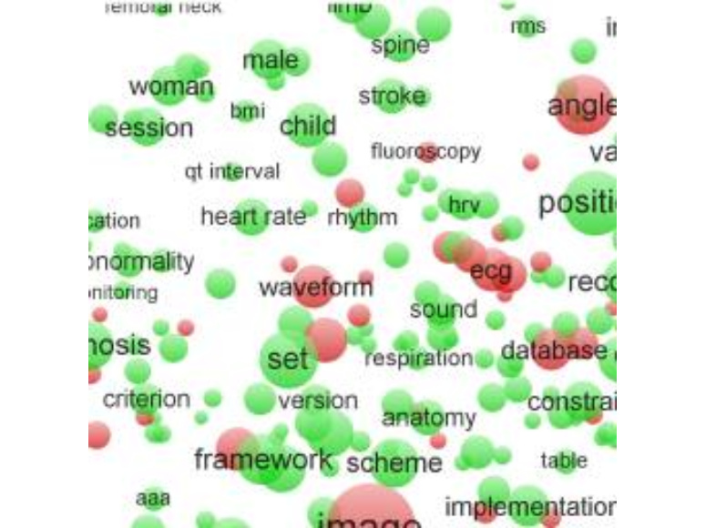
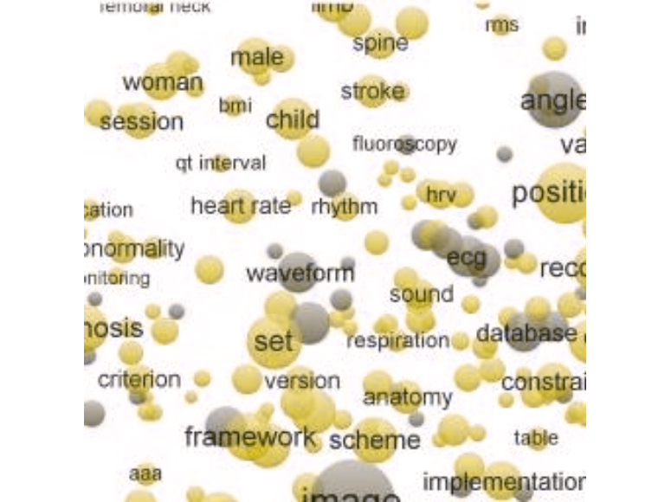
Color
Consider accessibility
https://coolors.co/
Coblis: https://www.color-blindness.com/coblis-color-blindness-simulator/
Notes:
There are a number of websites and apps that allow you to check how your visualisations will appear to those with colorblindness. Here I used Coblis to render the image as it would be seen by someone with severe deuteranopia.

Slide 27
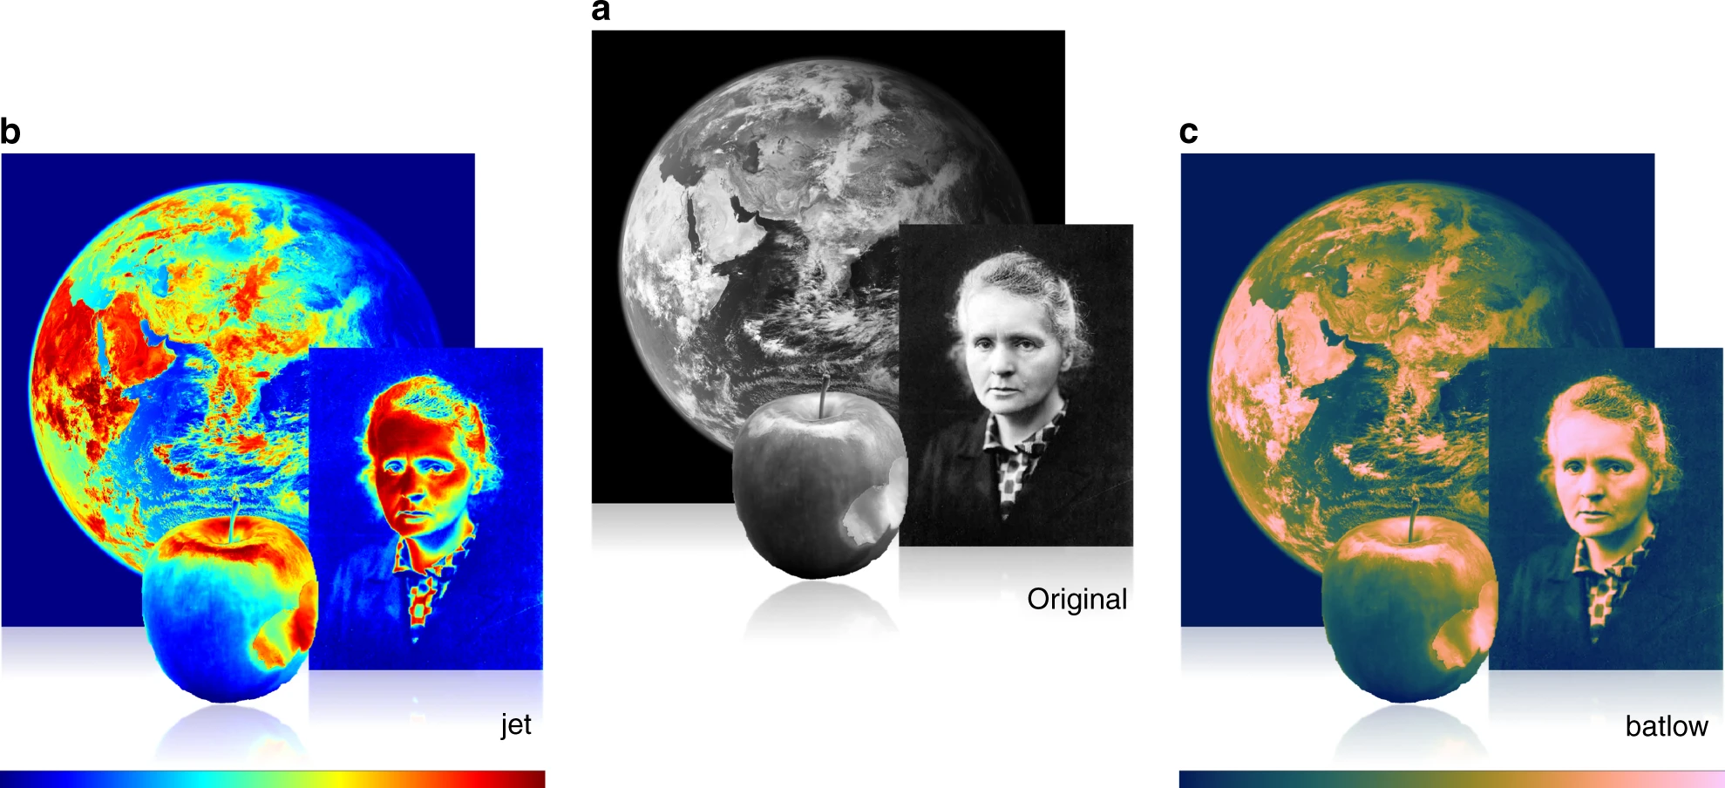
What do we gain or lose by using different color schemes?
Crameri et al. 2020

Slide 28
What do we gain or lose by using different color schemes?
Crameri et al. 2020

Slide 29
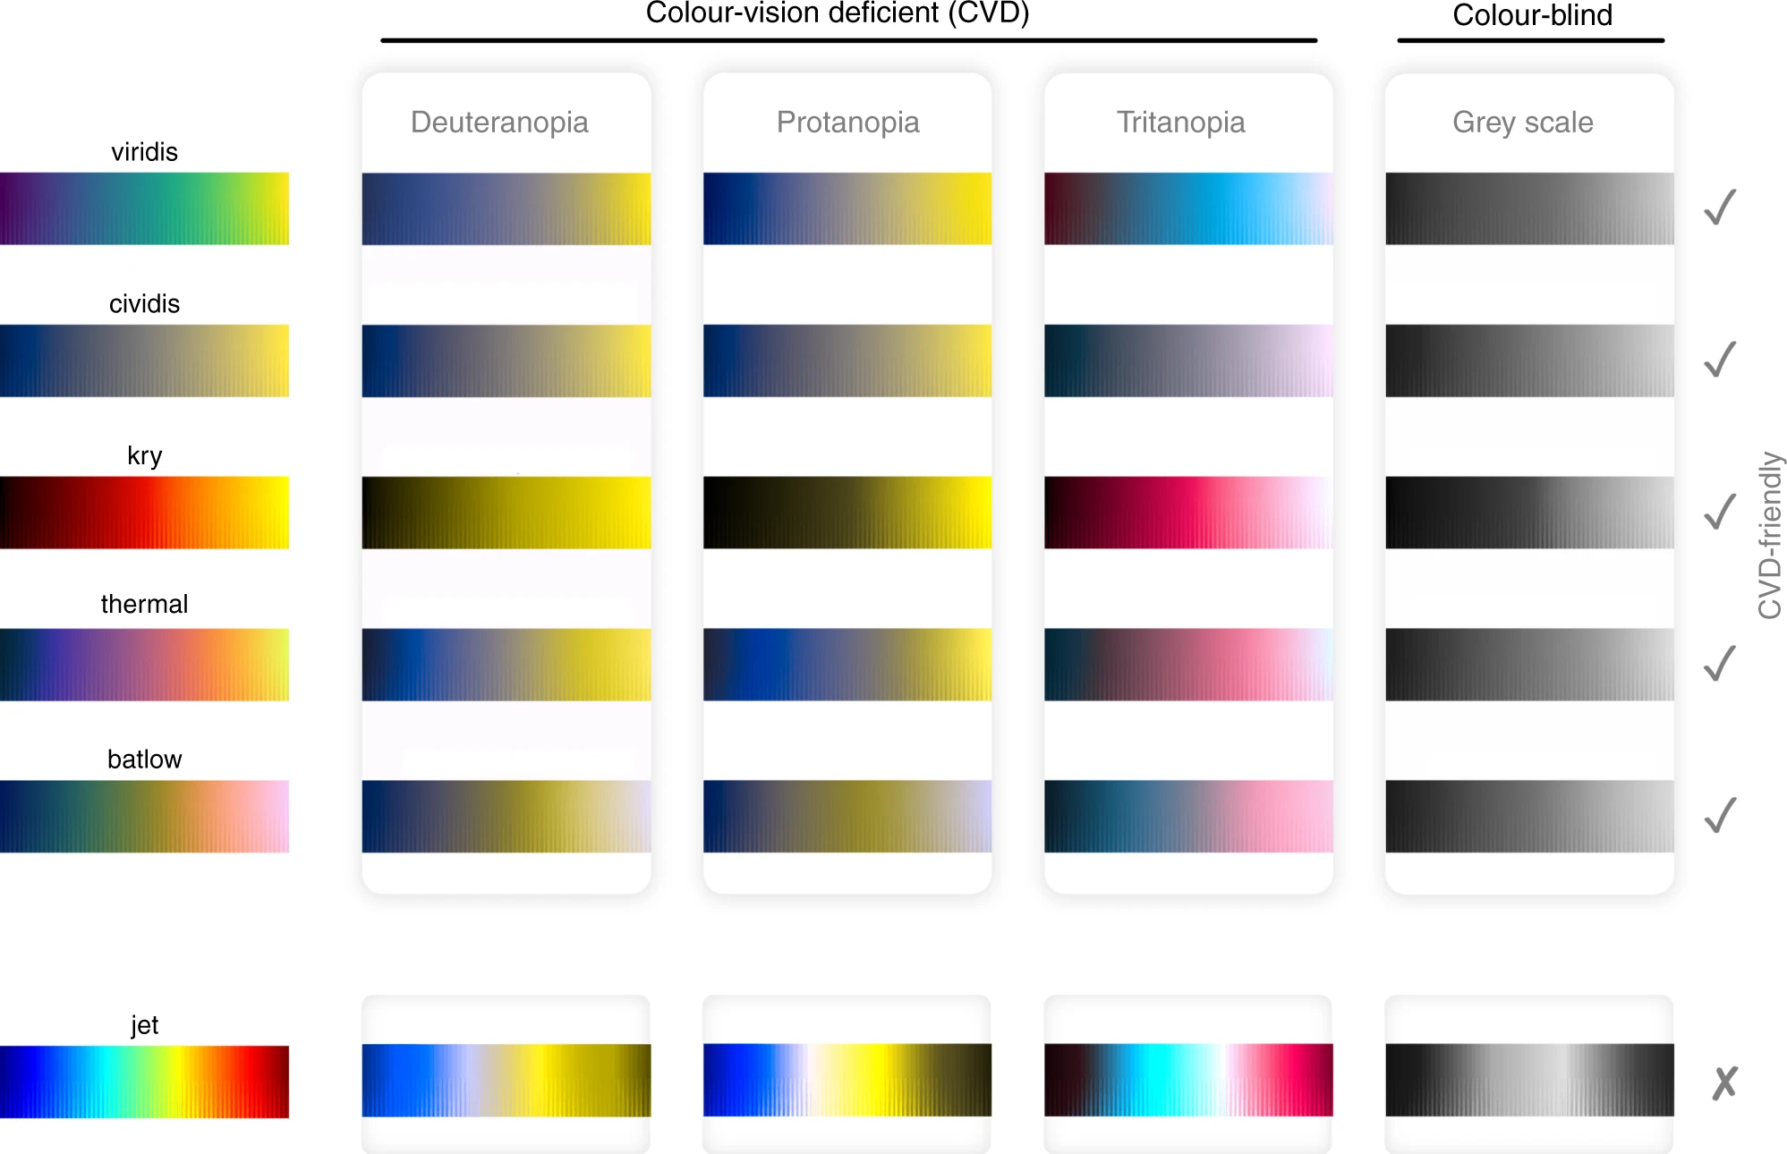
How do different people see different palettes?
Crameri et al. 2020

Slide 30
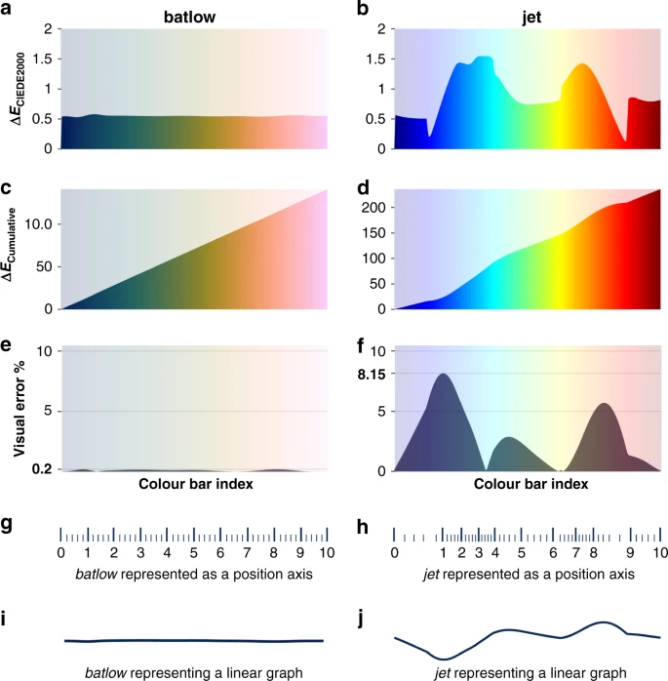
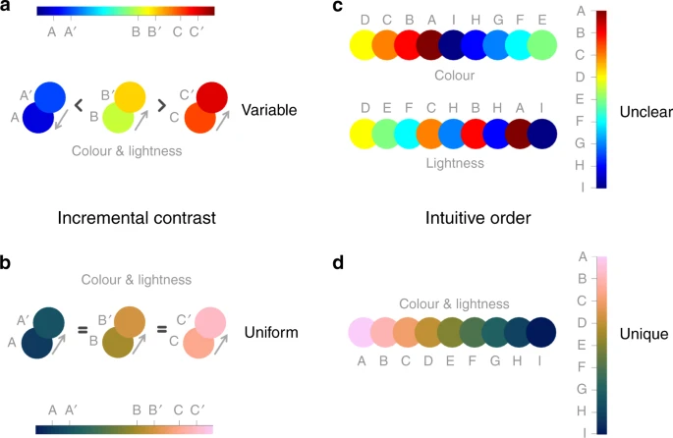
Batlow is versatile and robust.
Crameri et al. 2020

Slide 31
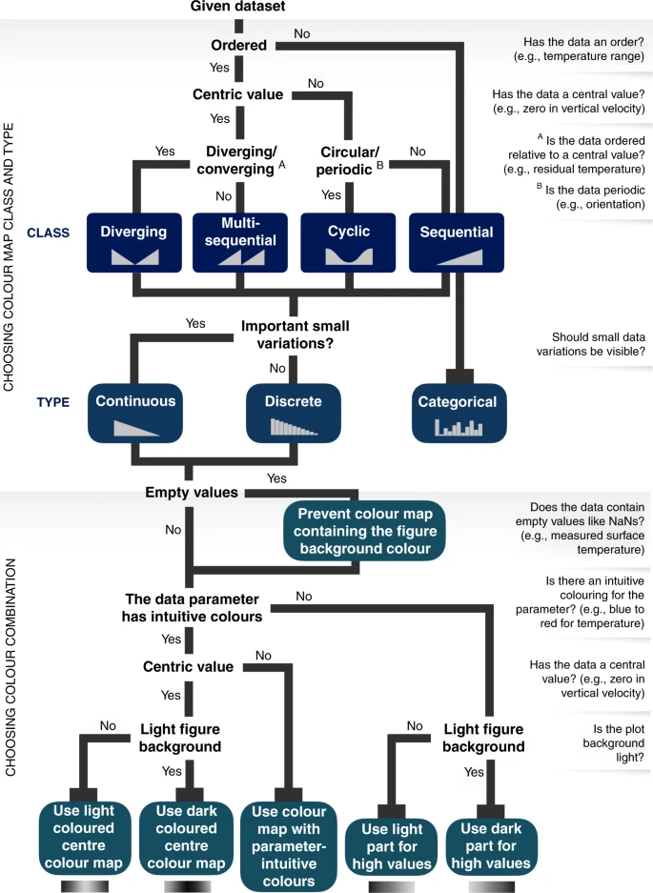

Slide 32
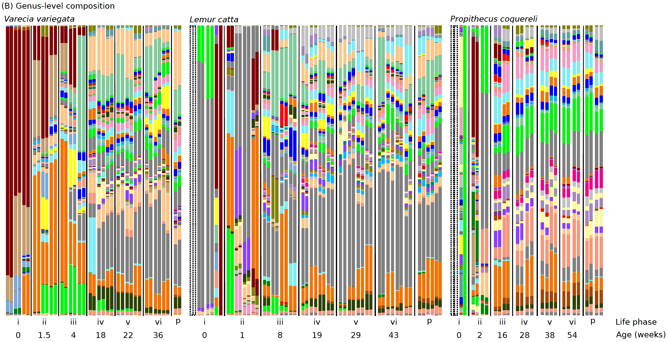
What are you trying to tell me?

Slide 33
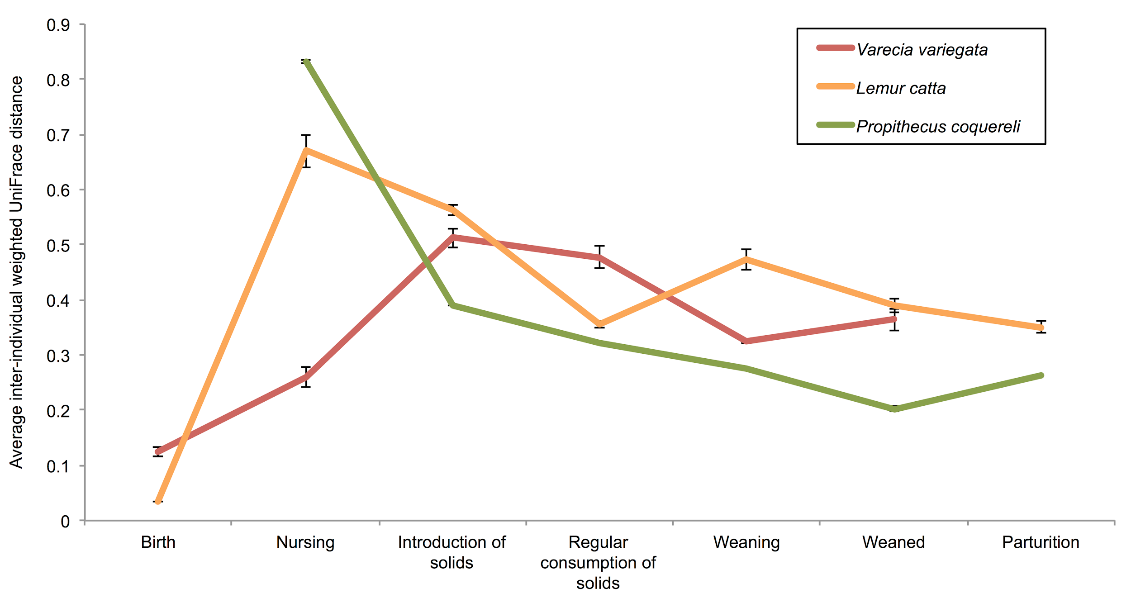
What are you trying to tell me?
Fewer differences between communities...

Slide 34
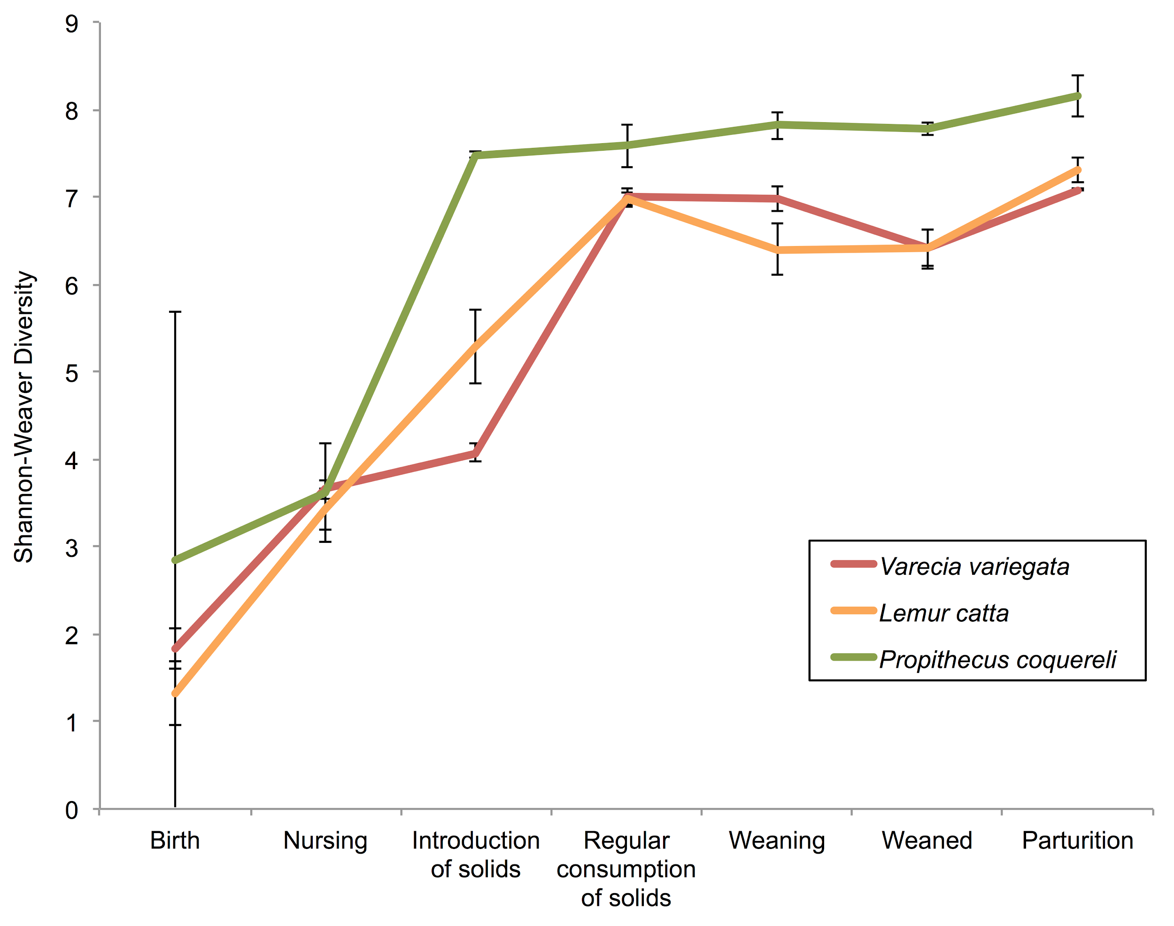
What are you trying to tell me?
...and more complex over time
Fewer differences between communities...

Slide 35
Data viz example from fall 2019

Slide 36
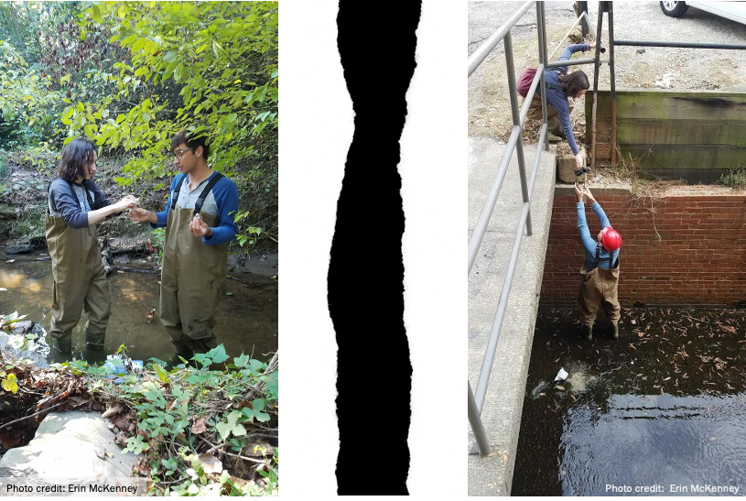

Slide 37
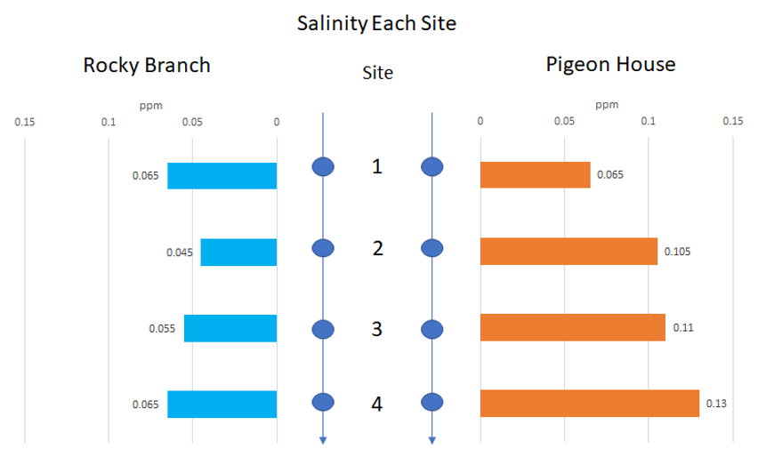

Slide 38
Recap: purpose of Data Vis
 | Exploratory | Presentation / publication
Audience | yourself | others
Figure type (example) | scatter | Line / bar chart
How to annotate with statistical results:
Ex: same figure (i.e. boxplot, barchart)
add * to denote significant p-values
Use color for comparison / salience

